Slide 1
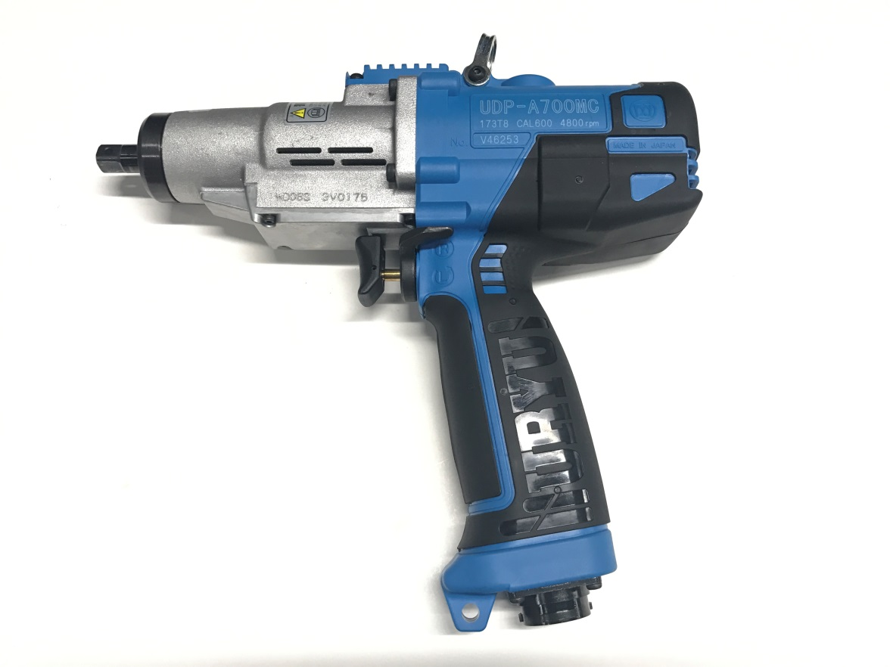
Messrs. Dongfeng Honda Automobile Co., Ltd.
URYU Transducerised Pulse Tool
UDP-A700MC

Slide 2
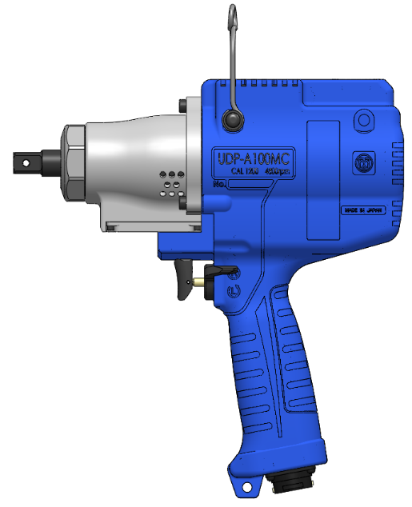
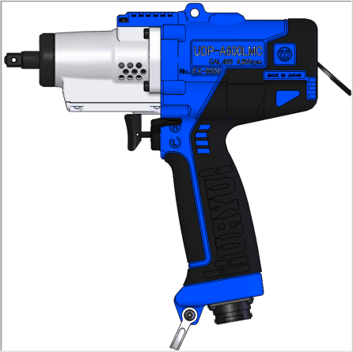
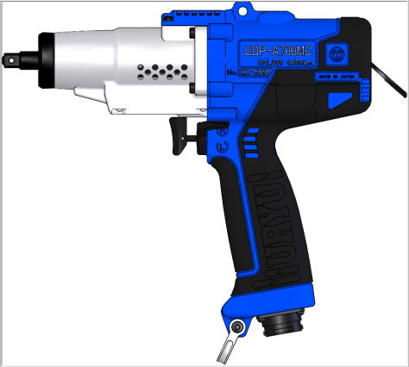
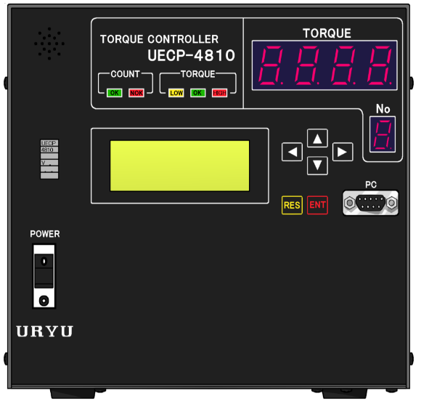
Upgraded UDP-MC series & UECP-4810 Controller 2017
URYU
Controller
UECP-4810
UDP-A600LMC
UDP-A700MC
UDP-A100MC
〇 Rotation Speed : Changeable between 1000 – 4800 r/min. in 100 r/min. increments => Accurate fastening
〇 Motor Torque : 4-Level Settings available => Accurate fastening
〇 Powerful Cooling Fan ⇒ Improved Productivity
〇 Auto Relief (PAT.) ⇒ Accurate Fastening
〇 Double Hit Error Detection
〇 Motor Driving Voltage : Adjustable (10 levels)
⇒ Wider Torque Range (UDP-A700MC covers 10Nm～50Nm.)
Specifications
Sound pressure measured in accordance with EN 62841-1 / Vibration in accordance with ISO 28927-2
Notes:
URYU developed the first electric pulse tool in the world. The first one was battery-powered UBP series. In 2000 we launched the first plug-in type electric pulse tool, UEP-MC series. Compared to UEP series (2000 rpm), the rotation speed is higher to improve productivity. Its casing is made of plastic for weight reduction. From our long experience with pulse tools, we developed patented Auto Relief function for the pulse unit to improve fastening accuracy. The biggest feature of UDP-MC is that you can change rotation speed between 1000 rpm and 4800 rpm in 100 rpm increment and in addition, motor current is selectable from four different levels. This feature helps to adjust the best tightening process per application and also make one tool to cover a wider torque range and more applications.

Slide 3
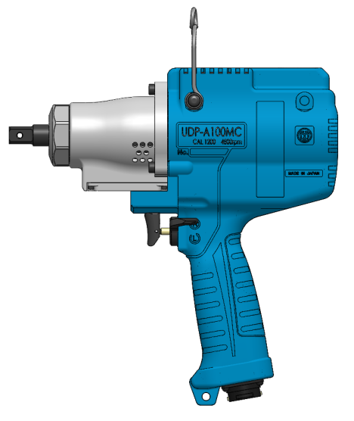
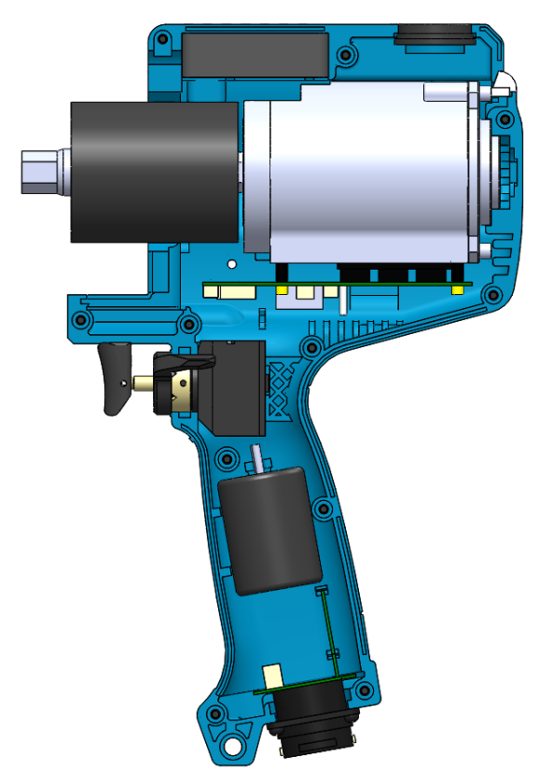
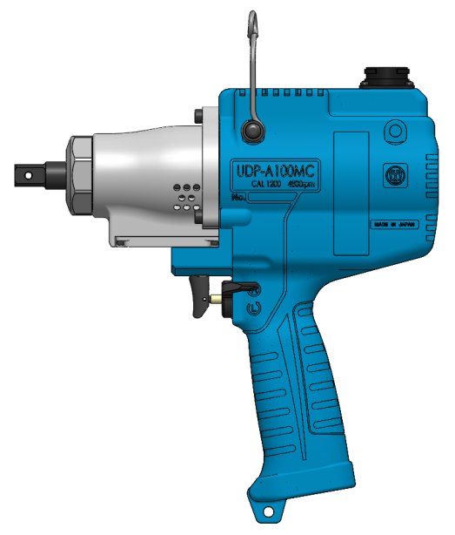
Upgraded UDP-MC Tool Construction
URYU
・Brushless Magnetostrictive Transducer
・Buzzer & LED to Confirm Fastening
・Powerful Cooling Fan
Suspension
Transducer
Cooling Fan
Motor
Buzzer
LED
Cable Connector
Pulse Unit
Switch
Cable Connector
UDP-A100MC(TL)
UDP-A100MC

Slide 4
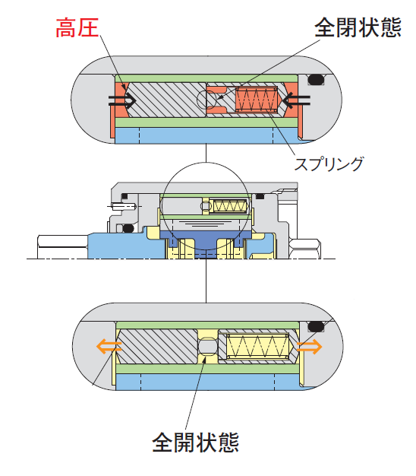
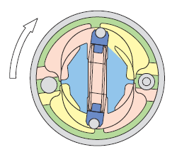
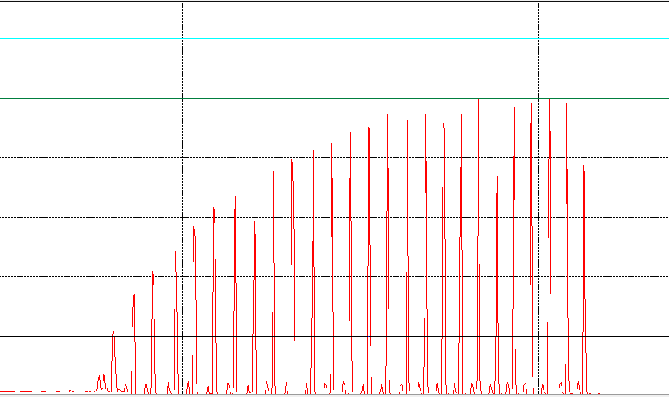
Features of UDP-MC Series
URYU
・Auto-Relief (PAT.)
Conventional relief valve changes the area of bypass which transfers the oil pressure generated in the pulse unit from high-pressured area to low to adjust torque and pulse number depending on target torque. Newly developed auto-relief automatically changes the area of bypass by changing oil pressure inside the pulse unit.
Auto Relief
・Torque spike – inhibited !
・Torque Accuracy – Improved !
・More Efficient Fastening !
Relief Valve (Fixed)
①
②
・2-Step Tightening Process
Motor Speed and Current (motor torque) level are programmable.
Stage ① = from Switch ON to START Torque
Stage ② = from START Torque to CUT Torque
CUT Torque
START Torque
・Torque spike – inhibited !
・Torque Accuracy – Improved !
① Switch ON – START Torque
② START Torque – CUT Torque
Notes:
The conventional features that help to improve accuracy are employed. Patented Auto Relief function and programmable motor speed and current (motor torque) level help to improve torque accuracy and to realize the most efficient tightening process on each application.

Slide 5
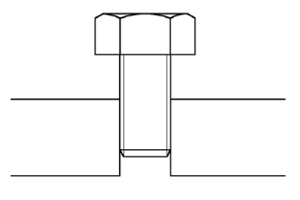
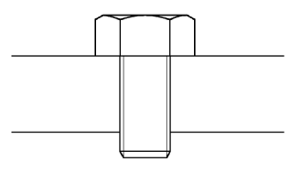
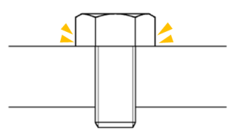
Upgraded UDP-MC New Functions
URYU
・Double Hitting Error Detection
Motor rotation angle (free run angle) from ‘Switching on the tool’ to ‘Reaching START torque’ is measured.
If you set up free run angle value and when free run angle value is less than the setting value, it judges ‘double hitting error’.
Motor rotation angle measurement from Motor Switch ON to Bolt-Seating point (START Torque)
No rotation means ‘Double Hitting Error’.
・Duty Cycle Setting Function
In addition to Speed (1000 rpm ～ 4800 rpm) and Current Level (4 levels), Motor Input Voltage can be programmable in 10% increments from 10% ～ 100% to change motor power output.
These programmable parameter contribute to fine torque adjustment and wider torque range.
※Use duty cycle function only when you use the tool at its very low torque level.
Model | Capacity | Torque Range | Free Speed | Overall Length | Weight w/o socket | Sq. Drive
 |  | (Nm) | r/min. | Mm | kg | mm
UDP-A60MC | M6-M8 | 5-25 | 4800 | 214.0 | 1.53 | 9.5
UDP-A80MC | M8-M12 | 25-55 |  | 242.0 | 1.78
UDP-A700MC | M6-M12 | 10-50 |  | 242.0 | 1.78
Notes:
The electric motor monitors free run angle from switching to reaching START torque. This function detects double hit errors by operators. Another new function is ‘Duty Cycle Setting’. This function helps to widen torque range of one UDP-MC model. The most popular model at one engine production is ‘UDP-A700MC’. This model covers from 10Nm up to 50Nm with Duty Cycle Setting function. Approx. 80% of UDP-MC tools at an engine production line is UDP-A700MC and the balance is shared by ‘UDP-A600LMC’ for lower torque range and ‘UDP-A100MC’ for higher torque range that UDP-A700MC cannot cover.
Wide-torque-range-model, UDP-A700MC, also improves durability. Durability of the conventional UDP-A60MC (～25Nm) used at its nearly maximum torque is not very good.

Slide 6

Upgraded UDP-MC series Improvement
URYU
Improvement from URYU Conventional UDP-MC
Item
Modified Points from Conventional UDP-MC
Advantage
・Detection of motor rotation angle from switch
lever ON to START torque to detect double hit
when the angle is lower than the setting angle
(Angle data is recorded by UECP-4810.)
Double Hit Error Detection
Control
Motor
・Motor driving voltage Adjustable (10 levels)
Improved Accuracy
・Fine adjustment of output
Mechanism
Pulse
Unit
・Decreased oil pressure inside the pulse unit
Increased Durability
・Increased fan capacity 0.11→0.16m³/min
Increased Durability
Fan
・Additional ventilation slots to cool the pulse unit
Fan
Ventilation slots
Notes:
The list shows the improved points from our old type UDP-MC tools.

Slide 7
Engine Production Tooling
URYU
One Japanese car manufacturer registered URYU UDP-A○○○MC series and YOKOTA e-M○○○ series for their engine production tooling. Here we would like to advise of URYU advantage over the other brand.
- Wider torque range per model ! This also saves running cost in the end!
One UDP-MC model covers a wider torque range. Only three UDP-MC models cover all the
necessary applications of their current engine production lines. On the other hand, other
brand requires four e-M models & one pneumatic model, Tka1400 for high torque application
(such as IN-WT assembly, 86Nm). Pneumatic model requires a different controller, which
forces users to keep more back up items.
- An electric tool for a higher torque range? We URYU, have a quick solution!
We have UDP-A120MC that covers even higher torque (up to 120Nm) and so, if you may
require an electric handheld fastening tool for higher torque job in future, it is easy to employ
UDP-A120MC at the production. The model works with the same controller, UECP-4810.
- Quick installation !
If you equip one engine line with UDP-MC/UECP-4810, it will be easy to set up tools and
controllers at the same applications at other lines by uploading setting parameters from the same application at the existing line to the new line. This saves your time to install tools and controllers.
Notes:
In case of URYU, the models are less and the controller is one type. But in case of Yokota, they need more e-M models and pneumatic transducerised model whose controller is different from e-M series. Therefore, user will have to keep more models and controllers for back up. But in case of URYU, user keep less items for back up, which will help them to save running cost.

