Slide 1
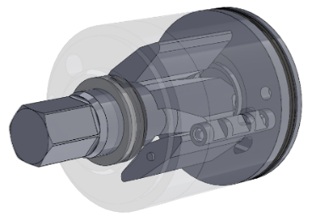
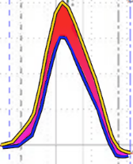
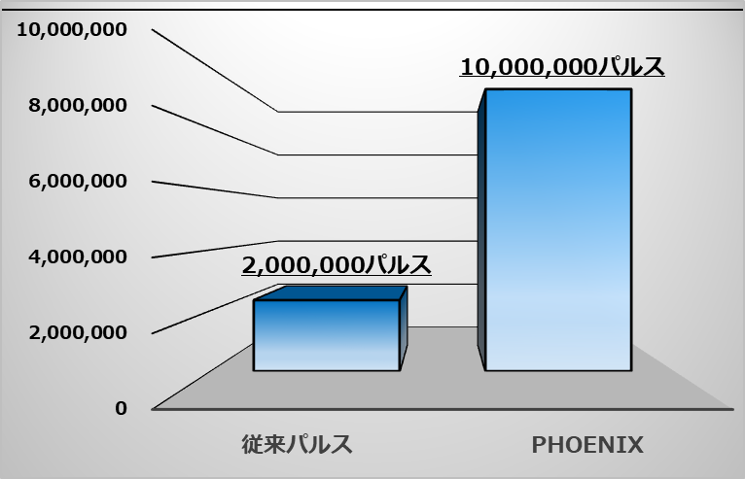
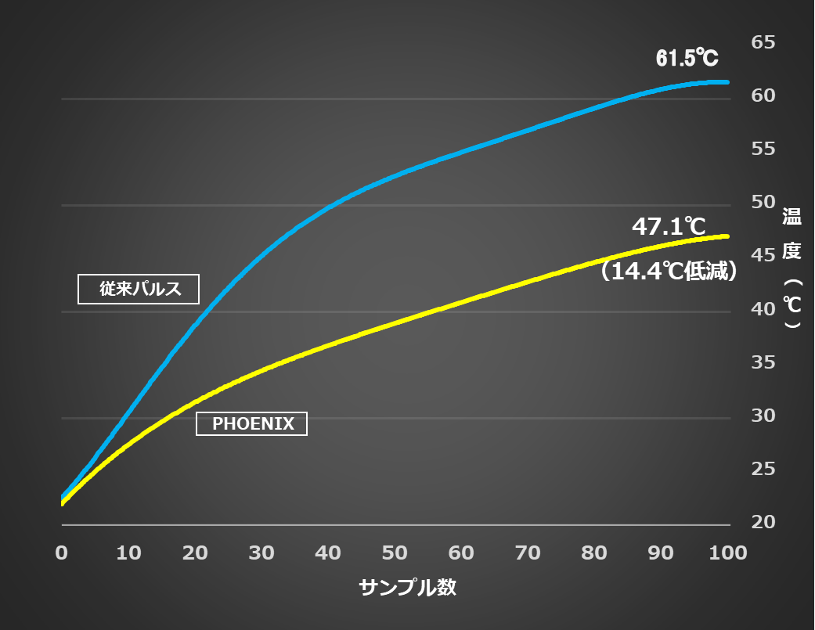

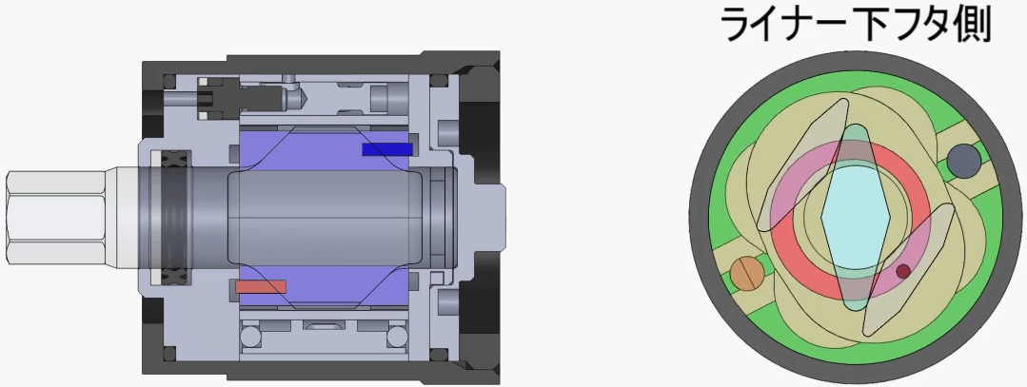
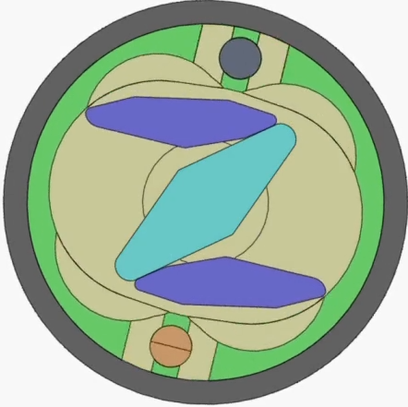


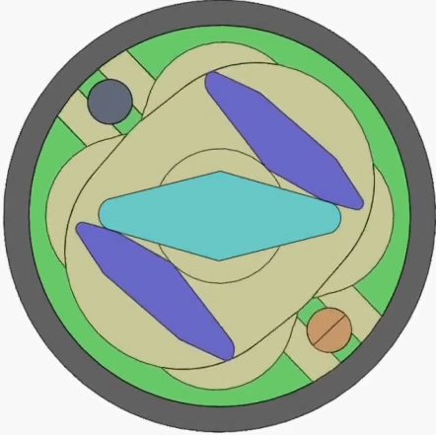
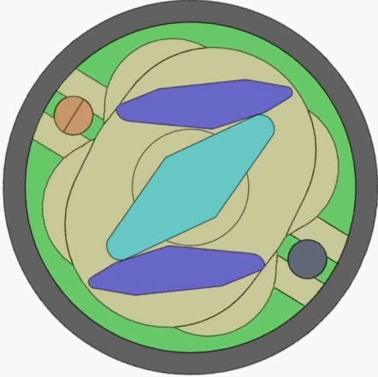
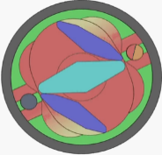
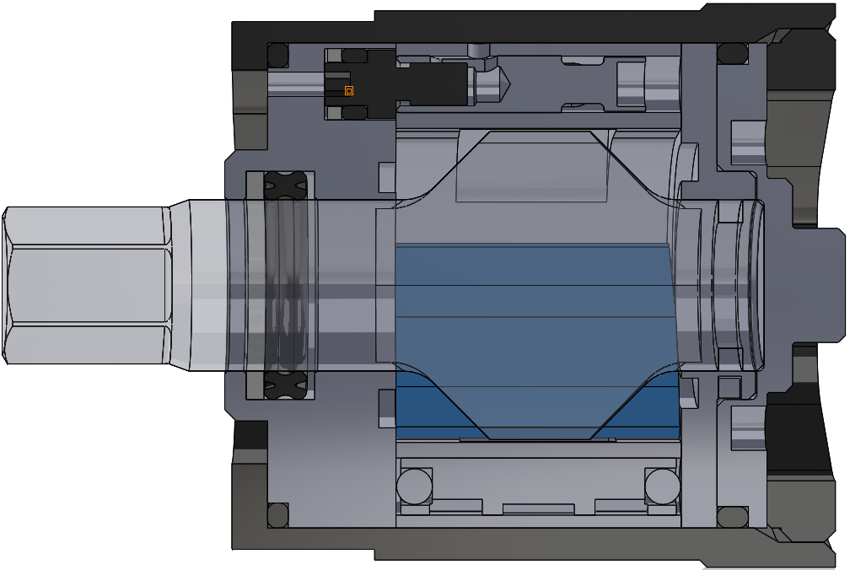
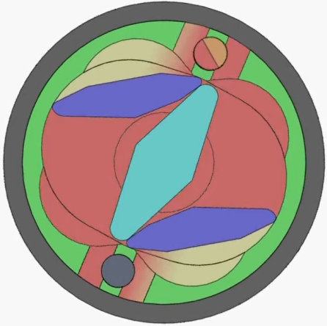

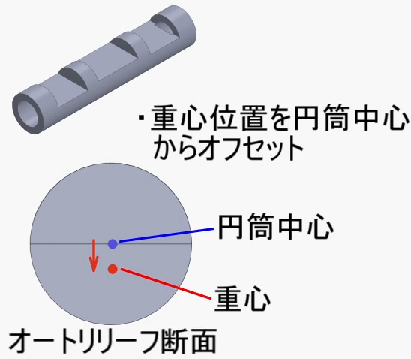
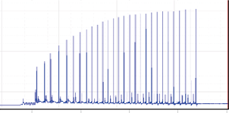




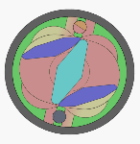
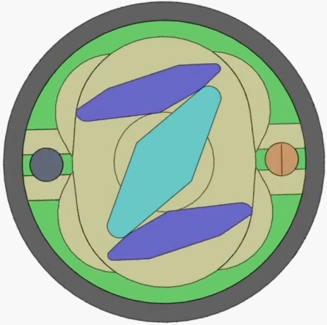




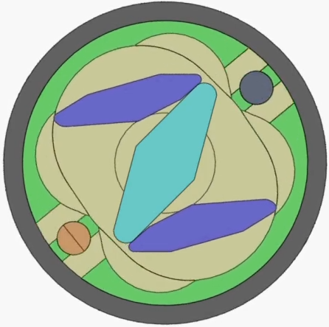

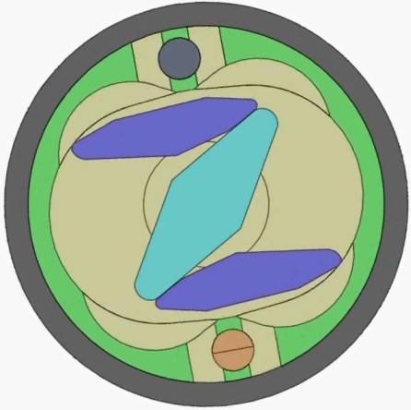
PhoeniX New Pulse Unit (PAT.P)
Improved Performance
URYU SEISAKU, LTD.
Output increases by 35%
Preventative Maintenance => 5 times!
Reduction of Oil Temperature increases by 30%
The innovative pulse unit has been newly developed with know-how cultivated by manufacturing pulse tools more than 40 years. A large increase of output and improvement of durability has been succeeded.
PHOENIX
Pulse Wave
10,000, 000 Pulse
PHOENIX
Conventional
Pulse Wave
Conventional Pulse Unit
2,000, 000 Pulse
14.4℃ decreased
Pulse Tool is reborn
PHOENIX
High－Power
Conventional Pulse Unit
Sample Table
1 Pulse Output Torque Wave
Pulse Counts until Pulse Maintenance
Temperature Increase Comparison (100 Fastenings)
Original
*Comparison with conventional pulse tool.
*Calculated under URYU test condition. It varies depending on the usage condition.
*Calculated under URYU test condition. It varies depending on the usage condition.
Newly Developed PHOENIX Pulse Unit
①
Start
Energy－Saving
Front Plate
Rear Plate
Front Plate Side
No Spring
Guide Pin
④
After Pulsing
②
Before Pulsing
Innovation
Driving Blade
X (10)million pulse : Prolonged Maintenance Cycle Time
Anvil
New Auto-Relief
③
During Pulsing
Maintenance Cycle: 10,000,000 pulse: 5 times in comparison with previous pulse units
Guide pins provided on one side of each driving blade are connected to the 180 ° decentered guide (groove) on the rear/front plate and oil inside the pulse unit and guide pins holds the driving blades. In addition, the driving blade is controlled on a regular track via decentered guide (groove) and guide pin. One impact per rotation can be made by sealing the pulse unit per rotation.
Features of PHOENIX Pulse Unit
Newly Developed Auto-Relief
◎New design with No springs helps to overcome challenges with conventional pulse tools.
・More powerful
・Minimizes temperature increase
・No need to warm up before use
◎Improved Durability
(Low oil pressure inside the pulse unit reduces the pressure against sealing, which improves oil leakage.)
◎Newly designed Auto-Relief (PAT.P) is not affected by oil degradation.
◎Less components make maintenance easier and save repair procedure time and repair cost.
Automatic adjustment
③
During Pulsing
(Rotation)
Wave Form
②
Before Pulsing
④
Just after Pulsing
Offset the center of gravity from the center of cylinder
(Revolution)
Center of Cylinder
Center of Gravity
Cutaway View of Auto-Relief
⑤
After Pulsing
Notches created on the auto-relief offsets the center of gravity, and the rotational motion of the pulse and the inertial force at blowing activate the auto-relief.
The notches on the auto-relief become bypass for oil, and the bypass is fully opened by centrifugal force due to rotation (revolution) when not pulsing, but the auto-relief rotates due to inertia when pulsing, and shut off the bypass unit.
①
Start

Slide 2
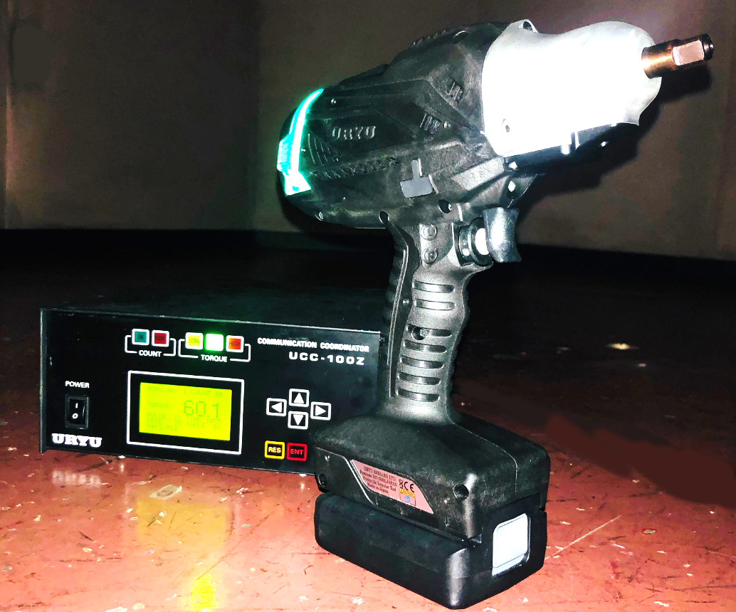
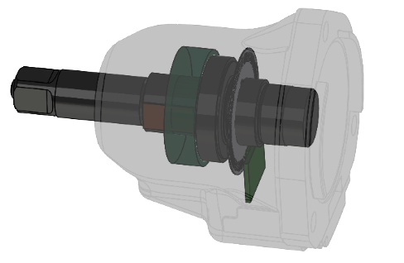
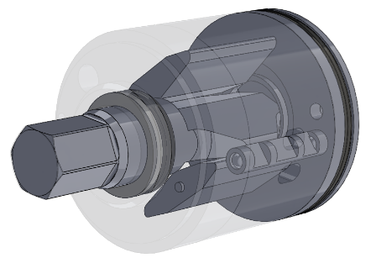
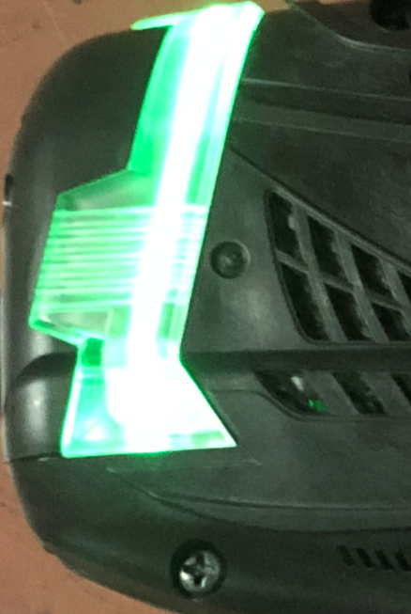
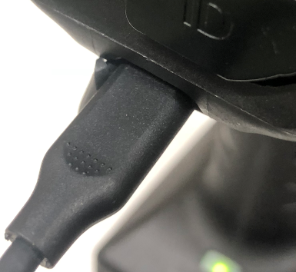
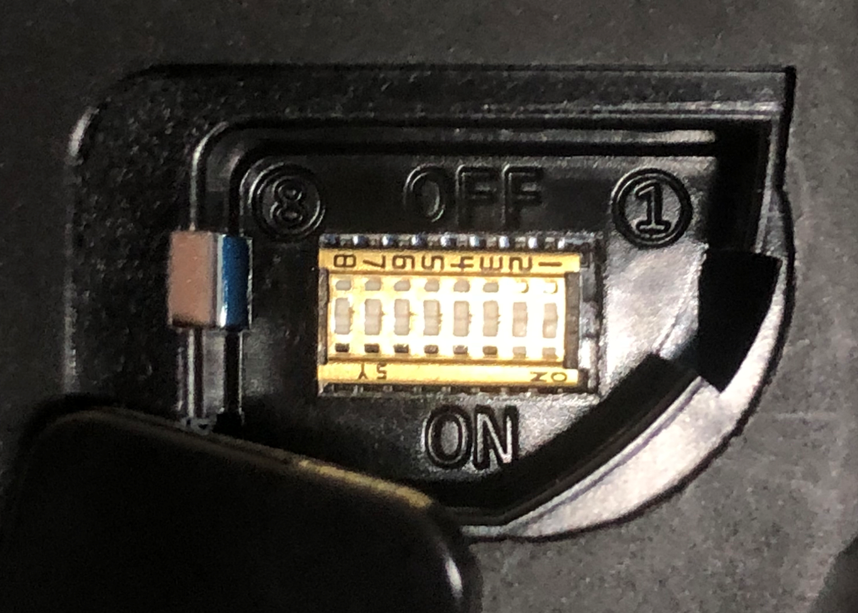
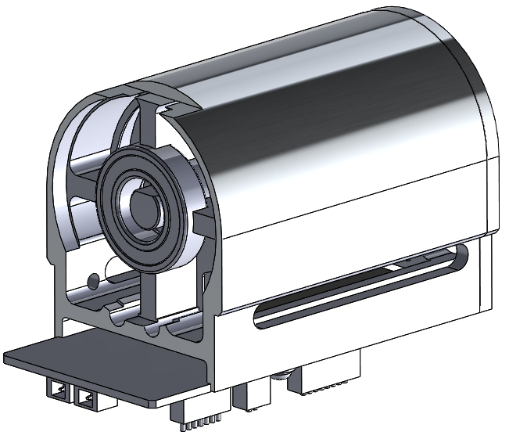
UBX-AF Series
Cordless Pulse Tool
Transducerised Cordless Pulse Tool
With Angle Feature
Newly developed Phoenix Pulse Unit and high-power DC motor makes high-torque fastening possible with low vibration & low reaction.
Phoenix Pulse enables maintenance cycle to prolong.
Torque and angle sensor are renewed to be small and lightweight. Torque and angle sensor are changed to non-contact type from rotating shaft, which increases the durability (impact resistance).
Precise fastening and reduction in operator’s workload improves the productivity.
Torque & Angle Sensor
Strain Gauge
Small and power saving torque and angle sensor are employed for battery-powered tool.
Torque measurement employs non-contact gauge type and angle measurement employs ultra-slim encoder. Small, but strong against vibration and noise. Very reliable sensor.
Non-Contact Torque Board
Ultra-slim Encoder
Newly developed Phoenix Pulse Unit (PAT.P)
Clear OK/NOK Judgement Lamp
Various Pairing Methods
Output => 35% increase *¹
Preventative Maintenance => 400% increase (10,000,000 pulse) *²
Reduction of oil temperature => 30% increase *²
These improvements ensure the maximum performance of electric tool. Newly developed auto-relief (PAT.P) makes the fastening possible with smooth and ideal torque wave form without being affected by oil degradation.
Upsized LED lamp enables operators to judge OK/NOK easily in any posture.
1. Manual Pairing by dip switches
2. Pairing through software
3. Wireless pairing
Fastening parameters are memorized in UCC-100Z coordinator. Quick tool change only by pairing!
*1 Comparison with the conventional equivalent model.
*2 Calculated under URYU test condition. It varies depending on the usage condition.
Newly developed compact & high-power DC Motor
Technical Specifications
Newly developed compact, lightweight and high-power DC motor
increases output and efficiency by employing high performance
magnet, compared to the conventional motor.
Quick & high-torque fastening is possible with small size battery by reducing the voltage required for operation and it leads to reduce the workload on the operator.
Model | Torque Range | Free Speed | Overall Length | Height | Weight | Battery Voltage | From Centre to Outside | SQ. Size | Number of Fastening per minute *2
 |  |  |  | （w/o battery） | （w/o battery） | (Capacity) *1
 | N・m | rpm | mm | Mm | Kg | V | mm | mm
UBX-AF500Z | 5～20 | 3,600 | 219 | 255（197） | 1.83（1.53） | 10.8 (2.0Ah) | 29.5 | 9.5sq. | 11
UBX-AF600Z | 15～40 | 4,800 | 219 | 255（212） | 1.88（1.53） | 14.4 (2.0Ah) | 27.3 | 9.5sq. | 10
UBX-AF700Z | 25～60 | 4,800 | 219 | 255（213） | 1.93 (1.58） | 14.4 (2.0Ah) | 27.5 | 9.5sq. | 9
*1 10.8V/14.4V/18V batteries are attachable. NOTE: The torque range varies depending on the battery size in use.
*2 Fastening Time: 0.5 sec.

